Slide 1
CHAPTER SIX SOILS, NATURAL VEGETATION AND WILDLIFE RESOURCES OF ETHIOPIA AND THE HORN

Slide 2
Objectives
At the end of this chapter you will be able to:
Identify major soil types of Ethiopia
Understand soil degradation and conservation measures
Describe the distribution of natural vegetations in Ethiopia
Explain the significance of wildlife resources of Ethiopia

Slide 3
Ethiopian Soils: Types, Degradation and Conservation
How does your local community identify and name soils?
How sever is erosion in your locality? Do you know the causes for its degradation?
Soil is a delicate but highly varied composition of mineral particles, organic matter and living organisms in dynamic equilibrium.
This variability reflects primarily the parent material from which the soil was formed over very long periods of time& the environment in which the soil has developed.
It consists of weathered mineral materials (45%), organic matter (5%), air (20-30%) and water (20-30%).

Slide 4
Soil formation is a long-term process.
It could take several thousands of years to form a single stratum of soil.
As it is a complex mixture of several constituents, its formation is also more complex.
The formation of a particular type of soil depends on parent material, climate, topography, living organism and time.

Slide 5
Weathering disintegrates the inorganic substances (rocks) of soils.
It is the breakdown of rocks at the Earth's surface, by the action of rainwater, extremes of temperature, and biological activity.
There are three types of weathering involving in soil formation. These are:

Slide 6
A. Mechanical (physical) weathering
Physical disintegration causes decrease in size without appreciably altering composition.
Differential stresses due to heating and cooling or expansion of ice break the rock.
Abrasion (erosion by friction) due to water containing sediment or wind carrying debris is another type of physical weathering.
B. Biological weathering
The process of biological weathering involves the weakening and subsequent disintegration of rock by plants, animals and microbes.
Roots of plant can exert pressure on rock.
Although the process is physical, the pressure is exerted by a biological process (i.e. growing roots).
Microbial activity breaks down rock minerals by altering the rock’s chemical composition, thus making it more susceptible to weathering.

Slide 7
C. Chemical weathering
Chemical weathering involves the modification of the chemical and mineralogical composition of the weathered material.
A number of different processes can result in chemical weathering.
The most common chemical weathering processes are hydrolysis, oxidation, reduction, hydration, carbonation, and solution.

Slide 8
Soils have two basic properties:
Physical properties
Soil physical properties are influenced by composition and proportion of major soil components.
Properties such as texture, structure, porosity etc. are categorized under physical soil properties.
These properties affect air and water movement in the soil, and thus the soil’s ability to function.
Chemical Properties
Soil chemistry is the interaction of various chemical constituents that takes place among soil particles and in the water retained by soil.
Soil properties like availability of minerals, electrical conductivity, soil pH, etc.
Soil chemical properties affect soil biological activity and indirectly the nutrient dynamics.

Slide 9
Major Soil Types in Ethiopia
Soils of Ethiopia are basically derived from crystalline, volcanic and Mesozoic sedimentary rocks.
Hence some of the soil divisions in the country are based on the geologic structure.
However, it should be born in mind that, there are soils formed due to long waited deposition of sediments.
FAO has identified 18 soil associations in Ethiopia at scale of 1:2,000,000.
Out of the major soils, 11 soil associations cover about 87.4 percent of the land area.
The six major groups of soils in Ethiopia are discussed under the following points:

Slide 10
A. Environmental condition i.e. parent material, climatic conditions, topography, the way they were formed.
B. Characteristic i.e. significant chemical and physical properties.
C. Agricultural suitability: in relation to texture, structure, topography, moisture-storage capacity, etc.
D. Occurrence: general location of the soil types.

Slide 11
1. Nitosols and Acrisols
Nitosols develop on gently sloping ground.
They are strongly weathered soils but far more productive than most other tropical soils.
They are basically associated with highlands with high rainfall and they were, probably, formed on forest covered areas originally.
Due to the high rainfall, there is considerable soil leaching which makes the nitosols to be poor in soluble minerals like potassium, calcium etc.; and rich in non-soluble minerals like iron and aluminum. The reddish-brown color of these soils is because of high concentration of iron (ferric) oxides due to leaching. But they are now widely found on cultivated areas and on mountain grasslands.
Nitosols are dominantly found in western highlands (Wellega), southwestern highlands (Kaffa, Illuababora), Southern highlands, Central highlands, and Eastern highlands.

Slide 12
Acrisols are one of the most inherently infertile soils of the tropics, becoming degraded chemically and organically very quickly when utilized.
Acrisols have very low resilience to degradation and moderate sensitivity to yield decline.
In Ethiopia, it has lost most of the base nutrients and are characterized by low productive capacity.
Acrisols are found along with nitosols mostly in some pockets of southwestern highlands of Ethiopia where there is high rainfall.

Slide 13
2. Vertisols
Vertisols are heavy clay soils with a high proportion of swelling clays when wet, and cracks when dry.
In Ethiopia, they are commonly found in parts of Northwestern, Central and Southeastern highlands (especially in Gojjam, Shewa, Arsi, Bale and central Hararghe).
3. Lithosols, Cambisols and Regosol
These soils are mostly found in rugged topography and steep slopes.
There is little evidence of pedogenic processes (soil forming processes).
As a result, they are young, shallow and coarse textured and so have low water holding capacity.
These soils are found in different parts of rugged and steep slopes of Central Highlands, on the Rift Valley Escarpments and highlands in of western Hararghe. Regosol and Lithosols are also found in the Danakil and eastern Ogaden.

Slide 14
4. Xerosols, Yermosols and Solonchaks
These are soils of desert or dry steppe soils majorly available in arid and semiarid areas.
Though the degree may vary, desert soils are characterized by high salt content and low organic content, because of the scanty vegetation.
These soils are extremely subjected to wind erosion and concentration of soluble salts.
Yermosols are even drier and more problematic than Xerosols.
Solonchaks are saline soils which develop in areas of high evaporation and capillary action. In Ethiopia, Xerosols are found in Ogaden and northeastern escarpments, whereas the Yermosols and Solonchaks cover the Ogaden and Afar plains. The Solonchaks are majorly located in salty plains of Afar.

Slide 15
5. Fluvisols
Fluvisols develop on flat or nearly flat ground, on recent alluvial deposits.
These soils are associated with fluvial (river), marine (sea) and lacustine (lake) deposits.
These are soils formed due to deposition of eroded materials from highlands.
The deposition takes place in depressions, lower valleys and lowlands.
Lower regions of rivers like Omo, Awash, Abay and the plains of Akobo and Baro Rivers are home for fluvivsols. Lakes region (main Ethiopian rift) is also characterized by fluvisols.
Fluvisols are highly variable, but much prized for intensive agriculture

Slide 16
6. Luvisols
Luvisols develop mainly in areas where pronounced wet and dry seasons occur in alternation.
Where leaching is not very high, they are found in association with nitosols.
Luvisols have good chemical nutrients and they are among the best agricultural soils in the tropics.
So, they are intensively cultivated.
However, when luvisols are found on steep slopes (stony) and on flat areas (waterlogged) they are avoided and left for grazing.
In Ethiopia, places with luvisols include Lake Tana area, parts of Northern, Central and Eastern Highlands and Southern lowlands.

Slide 17
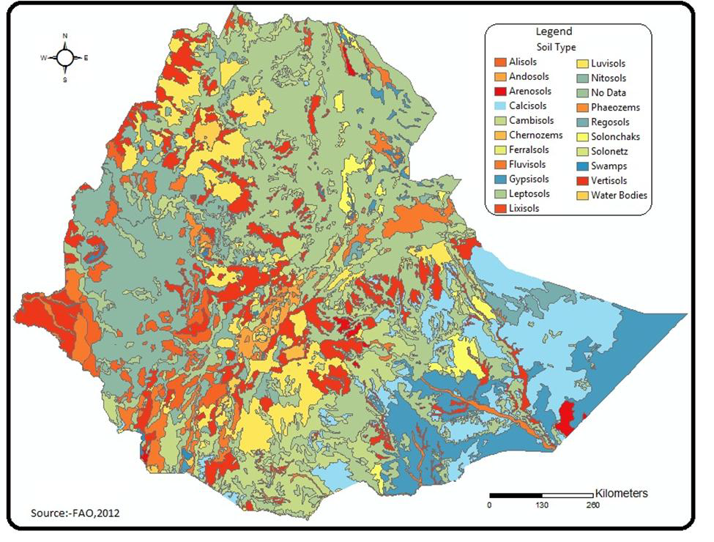

Slide 18
Soil Degradation
Soil degradation is defined as a change in any or all of soil status resulting in a diminished capacity of the ecosystem to provide goods and services.
It could also be the deterioration of the physical, chemical and biological properties of soil.
It is a critical and growing global problem.
It is a major concern for at least two reasons.
First, soil degradation undermines the productive capacity of an ecosystem.
Second, it affects global climate through alterations in water and energy balances and disruptions in cycles of carbon, nitrogen, sulfur, and other elements.

Slide 19
There are three major types of soil degradation. These are:
i. Physical Degradation: refers to the deterioration of the physical properties of soil. This includes:
Compaction: densification of soil is caused by the elimination or reduction of structural pores.
Soils prone to compaction are susceptible to accelerated runoff and erosion.
Soil erosion: is a three-phase process consisting of the detachment of individual soil particles, transportation and deposition.
The continuous strike of soil surface by rain droplets considerably weakness the soil and makes susceptible to erosion.
In Ethiopia, an estimated average of 42 tons per hectare of soils is eroded annually.

Slide 20
ii. Biological Degradation
Reduction in soil organic matter content, decline in biomass carbon, and decrease in activity and diversity of soil fauna are ramifications of biological degradation.
Because of prevailing high soil and air temperatures, biological degradation of soil is more severe in the tropics than in the temperate zone.
It can also be caused by indiscriminate and excessive use of chemicals and soil pollutants.
iii. Chemical Degradation
Nutrient depletion is a major cause of chemical degradation.
Chemical degradation is also caused by the buildup of some toxic chemicals and an elemental imbalance that is injurious to plant growth.

Slide 21
Causes of soil degradation
Soil degradation may result from natural and human-induced causes.
Topographic and climatic factors such as steep slopes, frequent floods and tornadoes, storms and high-velocity wind, high-intensity rains and drought in dry regions are among the natural causes.
Deforestation and overexploitation of vegetation, overgrazing, indiscriminate use of agrochemicals and lack of soil conservation practices, and over extraction of ground water are some anthropogenic causes of soil degradation.

Slide 22
Soil Erosion Control Measures
We have two major soil erosion control mechanisms. These are:
A. Biological Control measures
These types of soil erosion control mechanisms include vegetative strips, plantation, and reforestation.
Biological controls can prevent splash erosion, reduces the velocity of surface runoff, increases surface roughness which reduces runoff and increases infiltration, and etc.
B. Physical control measures
Physical measures are used to control the movement of water and wind over the soil surface.
The major types of physical erosion control measures commonly applied in Ethiopia includes terracing, check dams, gabion, trenches, contour ploughing, soil bunds etc.

Slide 23
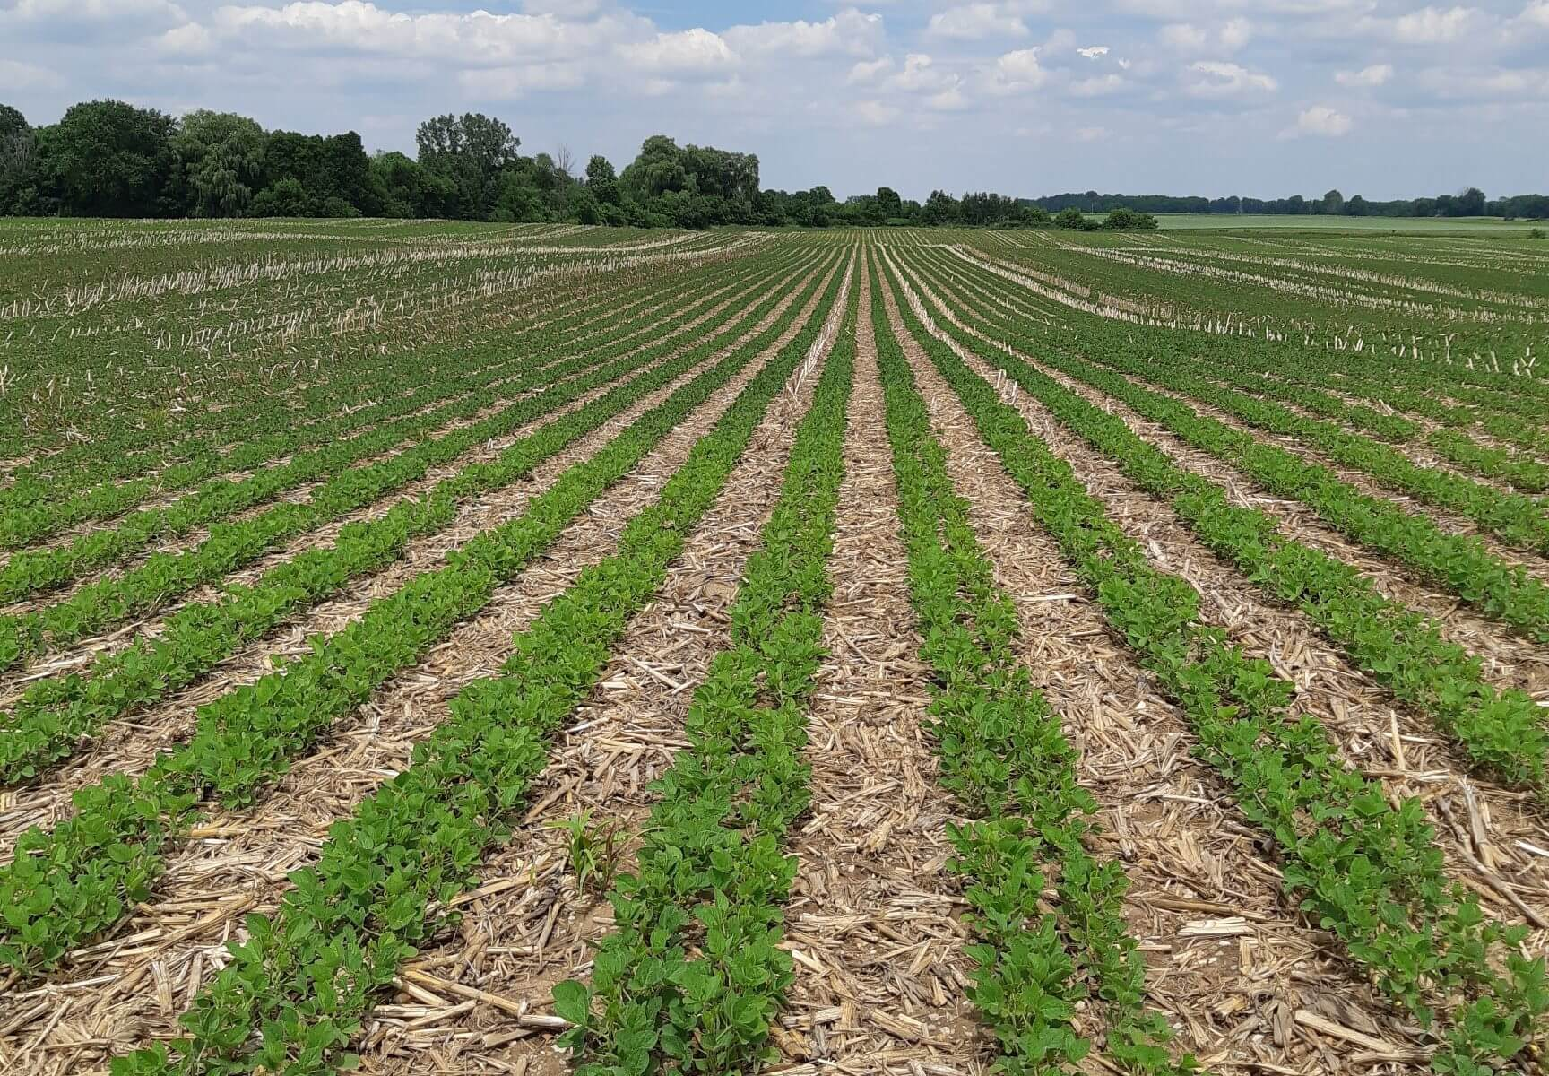
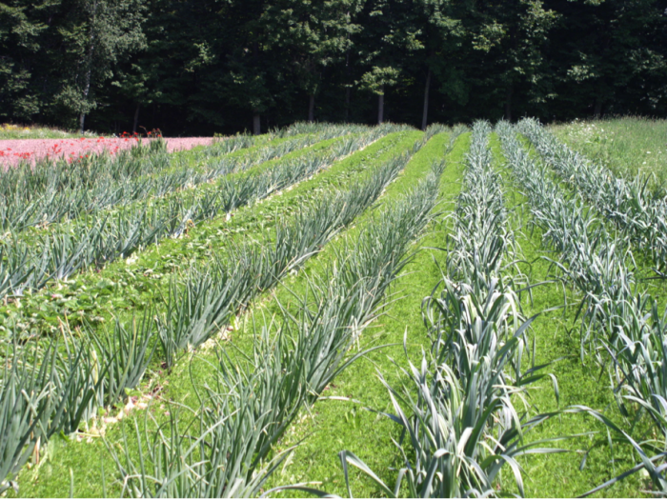
Strip cultivation
Biological Control measures
Inter-cropping

Slide 24
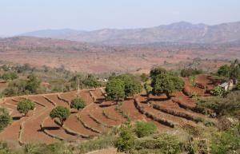
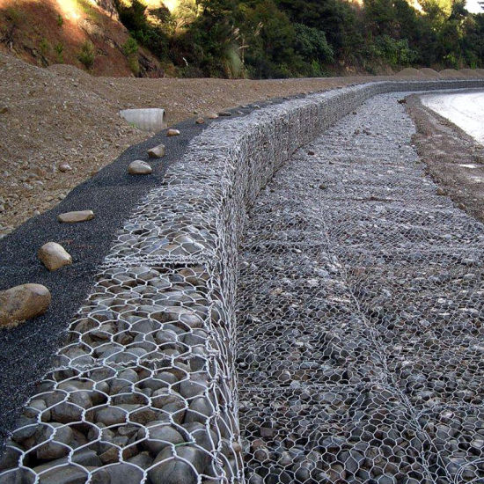
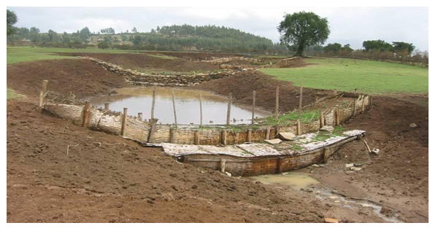
soil bunds
Gabions
Check Dams

Slide 25
Natural Vegetation of Ethiopia
Natural vegetation refers to a plant cover that develops with little or no human interference.
It can also be seen as any original plant cover grown in an area.
Its distribution on the surface of the earth is uneven majorly controlled by factors such as climate, soil types, drainage, etc.
However, to a large extent, temperature and precipitation affect the spatial distribution and the original plant cover of a region.
That is why, more than any other single element, the natural vegetation of an area becomes a very good indicator of the climatic conditions.

Slide 26
Natural vegetations are vital for human beings in many ways.
Plants can provide shelter, food, source of fuel, pasture and grazing, raw material for industries, source of timber and non-timber products.
The other uses include moderating effect on local climate, as home of wild life, medicinal values, minimizing soil erosion etc.

Slide 27
The characteristics of Ethiopia's natural vegetation are to a large extent determined by elevation (and temperature) and rainfall.
In Ethiopia, since temperature is mostly controlled by elevation, the spatial distribution of natural vegetation in the country is strongly correlated to it.
Lowlands due to their low rainfall and high temperature have harsh environment and are characterized by xeromorphic plants (plants which are adapted to drought and high temperatures).
Highlands (up to about 3000 m) are cooler than the lowlands and where there is adequate moisture a variety of forests can be seen.
Plants whose growth is limited by the low temperature characterize high altitude areas (mostly above 3000 m).
Ethiopia possesses an estimated number of 6000 species of higher plants of which 10% are endemic.

Slide 28
Major Natural Vegetation Types of Ethiopia
Taking altitude into consideration it is possible to broadly classify the vegetation belts of Ethiopia into the following five groups.
1. Afro-alpine and sub-afro alpine Region
2. Forest Region
3. Woodland Savannah Region
4. Steppe Region
5. Semi-desert Region

Slide 29
1. Afro-alpine and Sub-afro alpine Region
Ethiopia has the largest extent of Afro-alpine and sub afro-alpine habitats in Africa.
This vegetation type, also known as high mountain vegetation is similar to the Alpine vegetation in temperate regions.
These ecosystems are found on mountains having an elevation ranging between 3,200 and 4,620 meters above sea level.
The Afro-alpine habitat covers nearly 1.3% of the total landmass of Ethiopia.

Slide 30
The Afro-alpine region is found at very high altitudes (4,000 – 4,620 m).
Like any other landform in Ethiopian, the climate of Afro-alpine ecosystems is controlled by latitude and altitude.
The annul precipitation which ranges between 800 and 1,500 mm, is mostly in the form of sleet or snow.
Temperature records of 0ºC and below are widely experienced in these ecosystems.
The Bale and Semein mountains are typical examples of afro-alpine vegetation.
Compared to the Afro-alpine, the Sub-afro-alpine region is found at a lower elevation, roughly between 3,300 and 4,000 meters.
As a result, the plants in this region are adapted to somewhat less extreme environment than the Afro-alpine.

Slide 31
Vegetation in the Afro-alpine region consists of tussock grasslands, scrub, scattered mosses and lichens
while the Sub-afro alpine region is dominated by woodland, often degraded to scrub stages and also wet grasslands.
Lobelia rhynchopetalum (giberra) and Erica arborea (Asta) are some of the dominant species in the Afro-alpine and Sub-afro alpine regions respectively.

Slide 32
2. Forest Region
Forest is a complex ecosystem consisting predominantly of trees that shield earth and support numerous life forms.
Not all forests are similar in terms of species composition, structure and physiognomy.
In any geographical region, environmental factors such as climate, soil types, topography& elevation determine the types of forests.
In Ethiopia, forests are found at different elevations, 450 to 3,500m in humid parts and 2,300 to 3,300 m in most arid parts. Moreover, forests are characterized by variation in mean annual rainfall that range between 200 and 2,200mm.
These wide variations in rainfall and altitude result in two broad classification of forests: Highlands and Lowland forests.
Highland forests include Hagenia Abyssinia (Kosso), Juniper procera (tid), Arundinaria Alpina(kerkha), Podocarpus falcatus (zigba), Aningeria adolfi-friedericii (keraro)& Olea africana (Weyra)

Slide 33
Riverine forests are classified as lowland forests and are found in some places such as the banks of Awash, Wabishebelle, Ghenale etc.

Slide 34
3. Woodland Savannah Region
Like the forests, the woodland savannahs are also found in areas of wide altitudinal ranges (250 to 2,300 m).
Although the mean annual rainfall ranges between 200 and 1,400 mm, the large part of this region is found at a lower elevation and in a drier environment. Woodland savannah region can be broadly classified into three divisions:
Juniper procera (tid) is dominant species for both the Junipers Forests and Junipers Woodlands. The difference is in height: 3 - 45 meters tall in the forests and 10 -15 meters in the woodlands.
Acacia woodlands are dominated by both trees and shrubs, which belong to the same genus 'Acacia'. E.g. Acacia etbaica(grar),Acacia mellifera (Konter).
Mixed deciduous woodlands: As the name implies, most of the trees in mixed deciduous woodlands shed their leaves during the dry season.

Slide 35
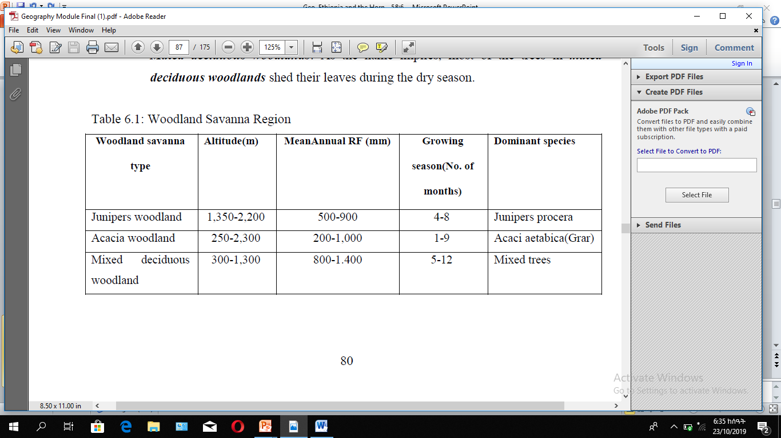

Slide 36
4. Steppe and Semi Desert Regions
These are regions in the arid and semiarid parts of the country where the temperature is very high and the rainfall very low.
Both are found at low elevations, the steppe at elevations of 100 to 1,400 m above sea level and the semi-deserts at 130 meters below sea level to 600 meters above sea level.

Slide 37
Natural vegetation Degradation
Over the past century, a rapid growth of the already dense Ethiopian population has led to overexploitation of the land.
In areas with settled agriculture, new land has been cleared at the expense of forests.
Ethiopia's forest resources have been disappearing at an alarming rate.
A century ago, forests covered about 40 percent of the total land area.
For the last few decades, forests have been cleared for different reasons.

Slide 38
Major causes for the gradual disappearance of the natural vegetation in Ethiopia are:
Clearing of forests for cultivation
Timber exploitation practices
Charcoal burning and cutting for fuel
Extensions of coffee and tea production areas
Overgrazing
Expansion of settlements both rural and urban, and clearing for construction

Slide 39
Natural Vegetation Conservation
There are three main approaches of biodiversity conservation:
Protection:
Sustainable forest management
Restoration or rehabilitation

Slide 40
Wild Life/wild animals in Ethiopia
Ethiopia is one of the few countries in the world, which possess unique and characteristic fauna with a high level of endemicity.
Existence of wide range of ecosystems endowed Ethiopia with great varieties of habitats contributing for the occurrence of high faunal diversity.
However, data on faunal resource of the country is as a whole is limited to mammals, birds, reptiles, amphibians and a few groups of arthropods.

Slide 41
Ethiopia has about 860 avian species (16 endemic species and two endemic genera), 279 species of mammals (31 endemic species and six endemic genera), 201 species of reptiles (14 endemic species), 23 species of amphibians (23 endemic species), and 150 freshwater fish (6 endemic species).
A total of 279 mammalian species of which 31 are endemic are known to occur in Ethiopia including those that require urgent conservation action i.e. Walia Ibex (Capra walie), Gelada Baboon (Theropithecus gelada), Mountain Nyala (Tragelaphus buxtoni), Ethiopian Wolf (Canis simensis), Starck‟s Hare (Lepus starcki).

Slide 42
Generally speaking, the main wild life concentrations in the country occur in the southern and western parts.
The wild animals in Ethiopia can be classified into five major groups:
Common wild animals (those animals that are found in many parts of the country (e.g. hyenas, jackals)
2. Game (lowland) animal, (which include many herbivores like giraffes, wild asses, zebras etc. and carnivores like lions, leopards, and cheetahs)
3. Tree animals or arboreals (which include monkeys, baboons)
4. A variety of birds in the Rift Valley lakes
5. Rare animals (gelada baboon and Semien fox) scattered in highlands; walia- ibex in the Semien Massifs, Nyala in the Arsi Bale massifs).

Slide 43
Wildlife Conservation
What are the challenges of wildlife conservation in Ethiopia?
Wildlife plays an important role in several ways.
The importance of wildlife can be categorized as ecological importance, economic importance, investigatory importance, conservation of biological diversities etc.
Wild animals can be used for:
➲ scientific and educational researches (valuable information for medical purposes and environmental studies)
➲ physical and mental recreation (aesthetic value)
➲ promotion of tourism (economic value)
➲ its potential for domestication
➲ maintaining ecological balance

Slide 44
To prevent the destruction of wildlife a total area of nearly 100,000 square kilometers of national parks, sanctuaries, community conservation areas, botanical gardens, wildlife reserves etc. have been established in different part of the country.
Hence in Ethiopia there are:
➲ 21 major national parks
➲ 2 major wildlife sanctuaries,
➲ 3 wildlife reserves,
➲ 6 community conservation areas,
➲ 2 wildlife rescue centers,
➲ 22 controlled hunting areas,
➲ 2 botanical gardens, and 3 biosphere reserves

Slide 45
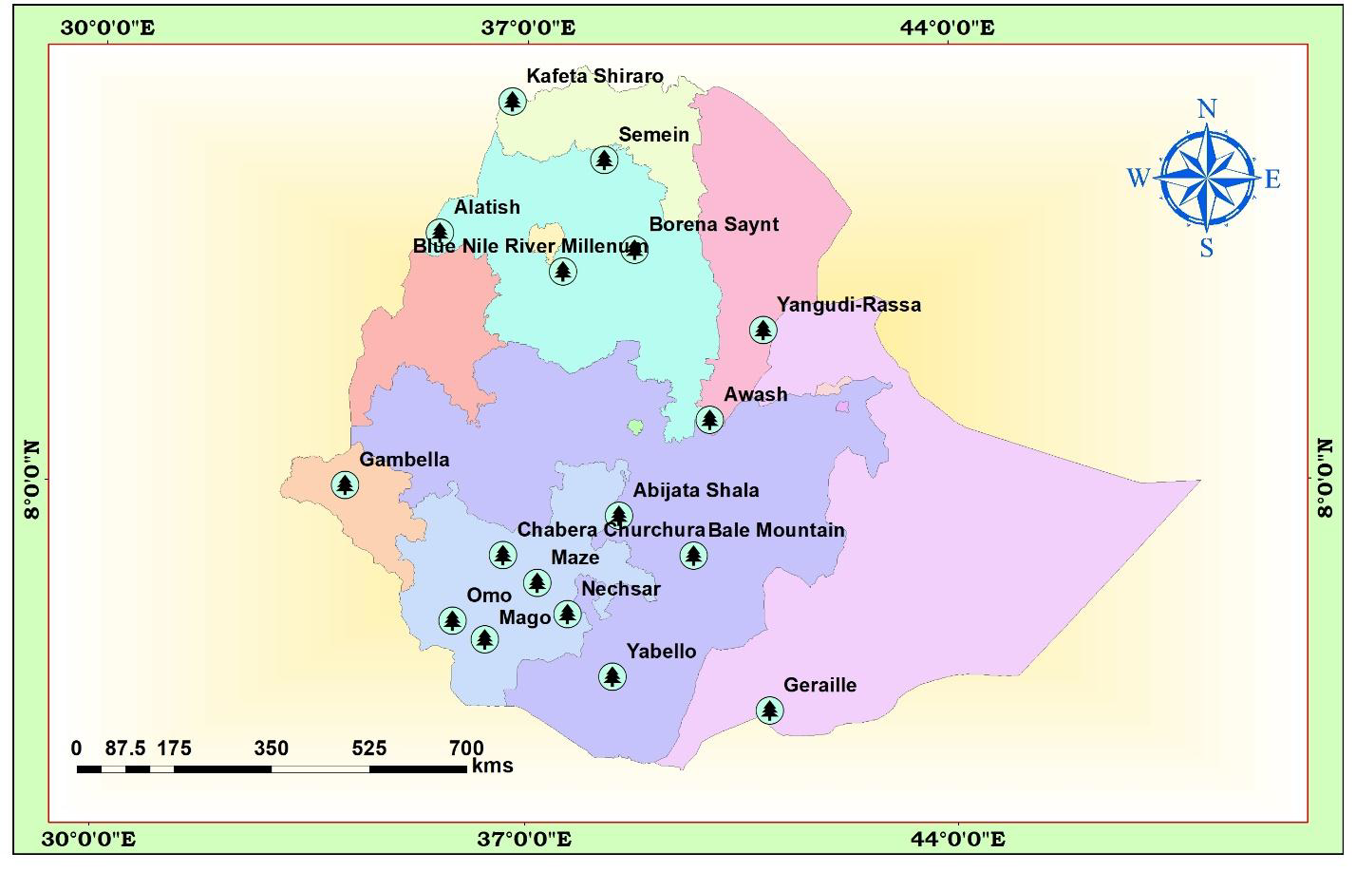

Slide 46
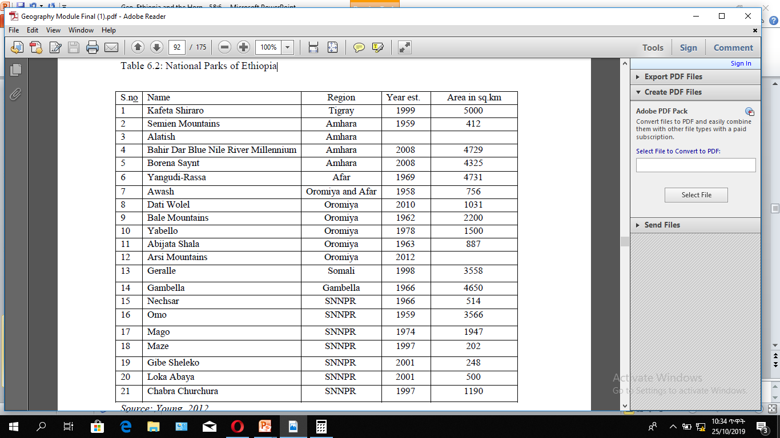
National Parks of Ethiopia

Slide 47
Some of the national parks are unique in their wild animals they have. E.g.
1. Abiyatta-Shalla lakes National Park is predominantly bird sanctuary. Important bird species include the flamingos and pelicans.
2. Omo, Mago, and Gambela National Parks have hippopotamus and crocodiles in rivers and lakes.
3. Semien and Bale Mountains National Parks have rare animals like Walia ibex, Semien fox, gelada baboon and Nyala.

Slide 48
Challenges of wildlife conservation in Ethiopia
The challenges include:
Limited awareness on the importance of wild life
Expansion of human settlement in protected areas.
Conflict over resource
Overgrazing (fodder and wood)
Illegal wildlife trade
Excessive hunting
Tourism and recreational pressure
Mining and construction material extraction
Forest fire

Slide 49
Thank You!

